Slide 1
Decorators & Unit testing & Multi-Threading with Asynchronisity

Slide 2
01
Decorators

Slide 3
Adnotations and Wrappers (Decorators)
Pytest uses adnotations
A function that takes another function as an argument and returns a modified version of that function
Used for logging, enforcing access control, instrumentation and caching
You can use as many decorators as you want for a function
def outer(f):
def inner(y):
result = f(y)
return result + y
return inner
@outer
def function(n):
n += 1
return n
First function – outer – gets as argument the function
Second function– inner – gets as argument the functions arguments
You must always return the inner function and the result itself (result + y in our case)

Slide 4
Adnotations and Wrappers
We don’t have arguments here
- func() doesn’t have args -
Example
def deco(f):
def wrap():
print("Before")
f()
print("After")
return wrap
@deco
def func():
print("Running...")
func()
Before
Running...
After

Slide 5
Adnotations and Wrappers
Example
def deco(f):
def wrap():
print("Before")
print("After")
return wrap
@deco
def func():
print("Running...")
func()
?

Slide 6
Adnotations and Wrappers
Example
def deco(f):
def wrap():
print("Before")
print("After")
return wrap
@deco
def func():
print("Running...")
func()
Before
After

Slide 7
Adnotations and Wrappers
Example
def admin_only(f):
"""Restricts access to admin users."""
def wrap(user):
if user != "admin":
return print("Access Denied!")
return f(user)
return wrap
@admin_only
def access_data(user):
print(f"Welcome {user}, access granted.")
access_data("guest")
access_data("admin")
Access Denied!
Welcome admin, access granted.

Slide 8
Decorators that use parameters
The wrapper name
What if we want to use a decorator with arguments?
– We have to create 3 functions !
The wrapper argument
def add_number(number):
def decorator(func):
def wrapper(*args, **kwargs):
return func(*args, **kwargs) + number
return wrapper
return decorator
@add_number(2)
def custom_function(n):
n += 1
return n
The function we attach the wrapper to
(see how the naming doesn’t have to match)
The function arguments
(we use args and kwargs to match any number/type of arguments)

Slide 9
Double decorators
def first_outer(function):
def inner(x):
print("This is the first decorator")
result = function(x)
return result + 3
return inner
@second_outer
@first_outer
def function(x):
x += 1
print(f"Main function called with {x}")
return x
print(f"Final result: {function(5)}")
def second_outer(function):
def inner(x):
print("This is the second decorator")
result = function(x)
return (result * 2)
return inner

Slide 10
Double decorators
@second_outer
@first_outer
def function(x):
x += 1
print(f"Main function called with {x}")
return x
print(f"Final result: {function(5)}")
def first_outer(function):
def inner(x):
print("This is the first decorator")
result = function(x) -> 15
return result + 3
return inner
def second_outer(function):
def inner(x):
print("This is the second decorator")
result = function(x) -> 7
return (result * 2)
return inner
function = second_outer(first_outer(function)) second_outer.inner(5)
↓ calls
first_outer.inner(5)
↓ calls
original_function(5) → returns 6
↑ returns 6
first_outer.inner → returns 6 + 3 = 9
↑ returns 9
second_outer.inner → returns 9 * 2 = 18

Slide 11
Double decorators
def first_outer(function):
def inner(x):
print("This is the first decorator")
result = function(x) -> 15
return result + 3
return inner
@second_outer
@first_outer
def function(x):
x += 1
print(f"Main function called with {x}")
return x
print(f"Final result: {function(5)}")
def second_outer(function):
def inner(x):
print("This is the second decorator")
result = function(x) -> 7
return (result * 2)
return inner
This is the second decorator
This is the first decorator
Main function called with 6
Final result: 18

Slide 12
02
Pytest & Asserts

Slide 13
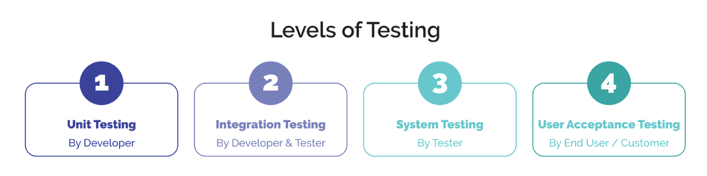
What is a unit test?
A unit test is a small piece of code that checks if a specific function or method in is an application works correctly.

Slide 14
What is pytest?
Python Framework used to write Unit Tests
Documentation: https://docs.pytest.org/en/stable/
Keeping Tests Simple and Focused on their purpose
Use Arrange – Act – Assert
A good practice is to separate them with comments
Use Proper Naming Conventions and Folder Structure
Tests should have this structure: test_{the function name we are testing}_returns{or whatever we expect as a “return”}_{the value we expected to receive}
Example: test_prime_number_returns_true
Optional you can add in the end for what input you expected this test to run properly: test_prime_number_returns_true_for prime_value
Tests should have their on folder for auto discovery (pytests know what tests you have based on folder structure and naming)
Each test file should have the word “test” in the beginning
It is good to structure your tests as separate as possible when it comes to folder structure
More conventions can be found here: https://docs.pytest.org/en/stable/explanation/goodpractices.html#conventions-for-python-test-discovery

Slide 15
Asserting with the assert statement
Basic Assert
def find_value_in_dict(key_to_find):
dictionary = {
”one": 1,
”two": 2,
”four": 4
}
return dictionary.get(key_to_find)
def test_find_value_in_dict_returns_expected():
assert find_value_in_dict(”one") == 1
assert find_value_in_dict(”two") == 2

Slide 16
Asserting with the assert statement
Assert about expected Exceptions
import pytest
def find_value_in_dict(key_to_find):
dictionary = {
”one": 1,
”two": 2,
”four": 4
}
return dictionary.get(key_to_find)
def test_find_value_in_dict_returns_TypeError():
with pytest.raises(TypeError):
find_value_in_dict([])
pytest.raises(TypeError, find_value_in_dict, key_to_find=[])
@pytest.mark.xfail(raises=TypeError)
def test_find_value_in_dict_return_TypeError():
find_value_in_dict([])

Slide 17
Asserting with the assert statement
Assert on Objects
class Fruit:
def __init__(self, name, color):
self.name = name
self.color = color
def __eq__(self, other):
return self.name == other.name and self.color == other.color
def test_ fruit_class_returns_false_for_different_objects():
f1 = Fruit("apple", "red")
f2 = Fruit("banana", "yellow")
assert f1 != f2
What happens if we
don’t have __eq__?

Slide 18
Asserting with the assert statement
Assert on Objects
class Fruit:
def __init__(self, name, color):
self.name = name
self.color = color
def test_ fruit_class_returns_false_for_different_objects():
f1 = Fruit("apple", "red")
f2 = Fruit("apple", "red")
assert f1 == f2
Assertion ERROR

Slide 19
Asserting with the assert statement
Assert on Objects
class Fruit:
def __init__(self, name, color):
self.name = name
self.color = color
def test_ fruit_class_returns_false_for_different_objects():
f1 = Fruit("apple", "red")
f2 = Fruit("apple", "red")
assert f1.name == f2.name
assert f1.color == f2.color

Slide 20
Mocks
What are mocks?
Mocks Replace Real Dependencies - substitute real objects/functions to isolate the code you're testing
Key concepts:
Use @patch as Decorator or Context Manager
Use with return_value and side_effect - control what your mocks return or do
Verify Mock Interactions with Assertions
Patch the Right Location (Import Path) - Critical: Patch where the function is used, not where it's defined:

Slide 21
Mocks in real life
from unittest.mock import patch
@patch('requests.get') # Replace real HTTP call
def test_api_call_returns_success(mock_get):
mock_get.return_value.json.return_value = {"status": "success"}
result = my_function_that_calls_api()
assert result == "success"
Testing using basic MOCK
@patch('email.send’)
def test_notification_is_called_once(mock_send):
send_welcome_email("john@example.com")
mock_send.assert_called()
mock_send.assert_called_with("john@example.com", subject="Welcome")
assert mock_send.call_count == 1

Slide 22
SIDE_EFFECT VS. RETURN_VALUE
RETURN_VALUE
SIDE_EFFECT
Simple Static Response - Returns the same value every time the mock is called
mock_function.return_value = "Hello"
# Every call returns "Hello"
result1 = mock_function() # "Hello"
result2 = mock_function() # "Hello"
Dynamic Behavior Provides different behavior for each call
mock_function.side_effect = ["First", "Second"]
result1 = mock_function() # "First"
result2 = mock_function() # "Second"
Raise exceptions
mock_function.side_effect = ValueError("Something went wrong")
mock_function() # Raises ValueError
Custom function
mock_function.side_effect = lambda x: x * 2
result = mock_function(5) # Returns 10

Slide 23
Fixtures
What are fixtures?
Fixtures are Setup/Teardown Functions - They replace repetitive setup code
Used in ARRANGE state
Automatic Dependency Injection - declaration function name should have the same name as the argument given in the testing function
Fixture Scopes Control Lifecycle - Scopes determine how often fixtures are created/destroyed
Fixtures Can Use Other Fixtures, creating a dependency chain
@pytest.fixture
def apple_fruit():
return Fruit("apple")
def test_fruit_returns_correct_name(apple_fruit):
assert apple_fruit.name == "apple"

Slide 24
Mocks vs. Fixtures What are the main 5 key differences?
1. Purpose
Fixtures: Prepare test data and environment (setup/teardown)
Mocks: Replace real dependencies to isolate code under test
2. What They Provide
Fixtures: Real objects, test data, database connections, etc.
Mocks: Fake objects that simulate behavior of real dependencies
3. When They're Used
Fixtures: Before/after tests run (setup and cleanup)
Mocks: During test execution to replace external calls
4. Control Level
Fixtures: Control test environment and initial state
Mocks: Control what external dependencies return/do
5. Testing Focus
Fixtures: Enable testing with consistent, known data
Mocks: Enable testing without external dependencies (isolation)
@pytest.fixture
def user_database():
return create_test_db()
@patch('email.send_email')
def test_user_signup(mock_email, user_database):
create_user("john@test.com", user_database)
mock_email.assert_called_once()

Slide 25
Pytest vs. UnitTest
1. Syntax & Simplicity
Unittest: Uses classes
Pytest: Uses basic functions
2. Assertions
Unittest: Special methods like assertEqual(), assertTrue(), assertRaises()
Pytest: Simple assert statements (more readable)
3. Test Structure
Unittest: Must inherit from unittest.TestCase
Pytest: Functions or classes, very flexible
4. Advanced Features
Pytest has built-in:
Parametrization (@pytest.mark.parametrize)
Better fixtures with dependency injection
Test discovery without imports
Unittest:
More basic, requires additional libraries for advanced features
Part of Python standard library (no installation needed)
5. Running Tests
Pytest: pytest (auto-discovers tests)
Unittest: python -m unittest or unittest.main()

Slide 26
Pytest vs. UnitTest
UniTest
class TestUser(unittest.TestCase):
def setUp(self):
self.user_data = {"name": "John"}
def test_user(self):
self.assertEqual(self.user_data["name"], "John")
Pytest
@pytest.fixture
def user_data():
return {"name": "John"}
def test_user(user_data):
assert user_data["name"] == "John"

Slide 27
03
Multi-Threading & asynchronisity - CURS 10

Slide 28
Threading in Python 3
In Python, a thread is a separate flow of execution that runs concurrently with other threads within the same process. Commonly used to perform tasks in the background or to make programs more responsive.
threading – module in python 3 that offers support for threading
Concepts:
Locks (Mutex)
Events
Semaphores
Barrier
ThreadPoolExecutor

Slide 29
Locks - Allows synchronized access to a resource (one resource only)
Can be used with context manager (“with” keyword)
Useful for files, databases etc.
Functions:
lock.acquire(blocking=True, timeout=-1)
lock.release()
One ATM, Many People
Imagine a neighborhood has only one ATM machine. Many people want to withdraw money, but:
🏧 Only one person can use the ATM at a time. If someone is using it, others have to wait.
This is exactly what a Lock does:
It ensures that only one thread can access a shared resource at a time.
Other threads wait until the lock is released.

Slide 30
Locks - Allows synchronized access to a resource (one resource only)
# Create a lock for the ATM
atm_lock = threading.Lock()
def use_atm(person):
print(f"{person} is waiting to use the ATM...")
with atm_lock: # Lock acquired here
print(f"{person} is using the ATM.")
time.sleep(random.uniform(1, 2)) # Simulate time at the ATM
print(f"{person} is done using the ATM.")
# Simulate 3 people wanting to use the ATM
people = [f"Person {i}" for i in range(1, 4)]
threads = []
for person in people:
t = threading.Thread(target=use_atm, args=(person,))
threads.append(t)
t.start()
for t in threads:
t.join()
Person 1 is waiting to use the ATM... 48:39
Person 1 is using the ATM. 48:39
Person 2 is waiting to use the ATM... 48:39
Person 3 is waiting to use the ATM... 48:39
Person 1 is done using the ATM. 48:41
Person 2 is using the ATM. 48:41
Person 2 is done using the ATM. 48:42
Person 3 is using the ATM. 48:42
Person 3 is done using the ATM. 48:44

Slide 31
Events - provides a way to synchronize execution between two or more threads
To synchronize two threads, two Events are usually used
Can be used with context manager (“with” keyword)
Functions:
set
clear
wait
is_set
Movie Night and the Projector Signal
Imagine a group of friends are sitting in a home theater, ready to watch a movie. The movie can't start until the host turns on the projector.
Everyone is seated and waiting, but no one will start watching until the host sends a signal — “Projector is on!” That’s when the movie watchers can proceed.
🟡 Until the signal is given, the watchers just wait.
This is exactly what a threading.Event is used for:
The event is like the "projector on" signal.
Threads wait for the event to be set before continuing.

Slide 32
Events - provides a way to synchronize execution between two or more threads
projector_on = threading.Event()
def movie_watcher(name):
print(f"{name} is waiting for the projector to turn on...")
projector_on.wait() # Block here until the event is set
print(f"{name} sees the projector is on and starts watching the movie!")
def host():
print(f"Host is setting up the projector...")
time.sleep(3) # Simulate setup time
print(f"Host turns on the projector!")
projector_on.set() # Send signal to all waiting threads
watchers = ["Alice", "Bob", "Charlie"]
threads = []
for person in watchers:
t = threading.Thread(target=movie_watcher, args=(person,))
threads.append(t)
t.start()
host_thread = threading.Thread(target=host)
host_thread.start()
for t in threads:
t.join()
host_thread.join()
Alice is waiting for the projector to turn on...13:20
Bob is waiting for the projector to turn on...13:20
Charlie is waiting for the projector to turn on...13:20
Host is setting up the projector...13:20
Host turns on the projector! 13:23
Alice sees the projector is on and starts watching the movie! 13:23
Bob sees the projector is on and starts watching the movie! 13:23
Charlie sees the projector is on and starts watching the movie! 13:23

Slide 33
Semaphores - Provides access to a limited number of threads to a resource
Can be used with context manager (“with” keyword)
Functions:
acquire()
release()
The Dining Philosophers Problem
There are 4 people that want to eat, but there are only 2 spoons.
🚪 Only 2 people can eat at once. Everyone else must wait until someone finishes eating.
This is exactly what a semaphore does:
It allows up to N threads to access a shared resource simultaneously.
In this case, N = 2, matching the number of spoons.

Slide 34
Semaphores - Provides access to a limited number of threads to a resource
# We have 2 spoons available and 4 people trying to use them.
spoons = threading.Semaphore(2)
def use_spoon(person):
print(f"{person} is waiting to use a spoon...")
spoons.acquire() # Try to use spoon
print(f"{person} is using a spoon.")
time.sleep(random.uniform(1, 3))
print(f"{person} is done using the spoon.")
spoons.release() # Leave spoon
# Create 4 people trying to use the spoons
people = [f"Person {i}" for i in range(1, 5)]
threads = []
for person in people:
t = threading.Thread(target=use_spoon, args=(person,))
threads.append(t)
t.start()
for t in threads:
t.join()
print("All people have used the spoons!")
Person 1 is waiting to use a spoon...
Person 2 is waiting to use a spoon...
Person 2 is using a spoon.
Person 1 is using a spoon.
Person 4 is waiting to use a spoon...
Person 3 is waiting to use a spoon...
Person 2 is done using the spoon.
Person 4 is using a spoon.
Person 1 is done using the spoon.
Person 3 is using a spoon.
Person 4 is done using the spoon.
Person 3 is done using the spoon.
All people have used the spoons!

Slide 35
Barrier - Provides a mechanism to wait for multiple threads to start at the same time.
A Barrier is used to make a group of threads wait until a certain number of them have reached a specific point in execution (called a rendezvous point)
Can be used with context manager (“with” keyword)
Functions:
wait()
reset()
abort()
parties()
Workers Assembling a Car
Imagine you're managing a project that has to assembly a car in a factory. You have three workers, each responsible for one crucial step:
Worker A installs the engine
Worker B installs the doors
Worker C installs the wheels
Now, after all three parts are installed, a final quality check must be done.
⚠️ The quality check can only happen once all three workers have finished their tasks.
If one worker finishes early, they must wait until the others are done — nobody can proceed until everyone reaches the checkpoint.

Slide 36
Barrier - Provides a mechanism to wait for multiple threads to start at the same time.
barrier = threading.Barrier(3)
def worker(name, task):
print(f"{name} is doing: {task} at time: {datetime.now().strftime('%M:%S')}")
time.sleep(random.uniform(1, 3))
print(f"{name} finished {task} at time: {datetime.now().strftime('%M:%S')}, waiting at barrier...")
barrier.wait()
print(f"{name} proceeds to quality check at time: {datetime.now().strftime('%M:%S')}.")
workers = [
("Worker A", "Install Engine"),
("Worker B", "Install Doors"),
("Worker C", "Install Wheels"),
]
threads = []
for name, task in workers:
t = threading.Thread(target=worker, args=(name, task))
threads.append(t)
t.start()
for t in threads:
t.join()
Worker A is doing: Install Engine at time: 56:05
Worker B is doing: Install Doors at time: 56:05
Worker C is doing: Install Wheels at time: 56:05
Worker B finished Install Doors at time: 56:06, waiting at barrier...
Worker A finished Install Engine at time: 56:07, waiting at barrier...
Worker C finished Install Wheels at time: 56:08, waiting at barrier...
Worker C proceeds to quality check at time: 56:08.
Worker B proceeds to quality check at time: 56:08.
Worker A proceeds to quality check at time: 56:08.

Slide 37
ThreadPoolExecutor
ThreadPoolExecutor class exposes three methods to execute threads asynchronously.
Functions:
submit(fn, *args, **kwargs)
map(fn, *iterables, timeout = None, chunksize = 1)
shutdown(wait = True, *, cancel_futures = False)
Restaurant with Limited Waiters
Imagine a busy restaurant with many customers arriving at once. The restaurant has only 3 waiters who can take orders and serve food.
Customers arrive and wait for a waiter to become free.
Each waiter handles one customer’s order at a time.
When a waiter finishes serving a customer, they move on to the next waiting customer.
This is similar to a thread pool:
You have a fixed number of worker threads (waiters).
Tasks (customers) are assigned to free threads.
Threads are reused efficiently rather than creating a new one for each task.

Slide 38
ThreadPoolExecutor
def serve_customer(customer_id):
print(f"Waiter starts serving customer {customer_id}")
time.sleep(random.uniform(1, 3)) # Simulate time taken to serve
print(f"Waiter finished serving customer {customer_id}")
# Maximum 2 waiters available
with concurrent.futures.ThreadPoolExecutor(max_workers=2) as executor:
# Simulate 5 customers arriving
customers = range(1, 6)
executor.map(serve_customer, customers)
Waiter starts serving customer 1
Waiter starts serving customer 2
Waiter finished serving customer 2
Waiter starts serving customer 3
Waiter finished serving customer 1
Waiter starts serving customer 4
Waiter finished serving customer 4
Waiter starts serving customer 5
Waiter finished serving customer 3
Waiter finished serving customer 5

Slide 39
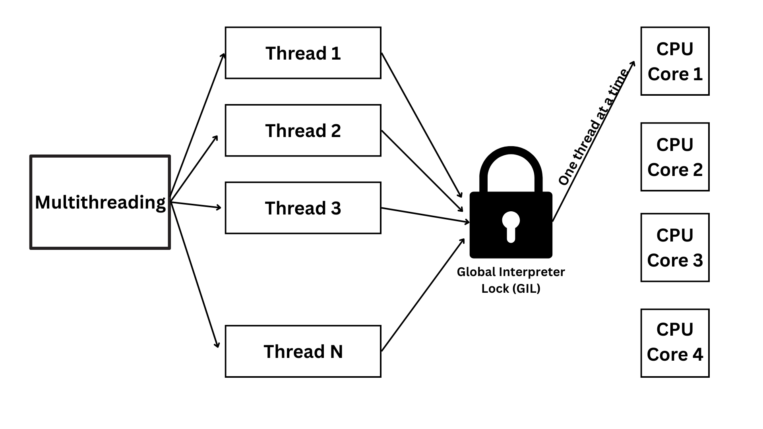
GIL (Global Interpreter Lock)
The Global Interpreter Lock (GIL) in Python is a locking mechanism that ensures that only one thread can execute Python code at a time, even on multi-core processors.

Slide 40
Tricking GIL - Alternatives to working around the GIL
Multiprocessing
from multiprocessing import Process
def compute():
total = 0
for _ in range(10**7):
total += 1
p1 = Process(target=compute)
p2 = Process(target=compute)
p1.start()
p2.start()
p1.join()
p2.join()
Async IO
import asyncio
async def fetch_data():
print("Fetching...")
await asyncio.sleep(2)
print("Done")
async def main():
await asyncio.gather(fetch_data(),fetch_data())
asyncio.run(main())

Slide 41
⚠️ Important Concepts
GIL (Global Interpreter Lock):
Python threads don't run truly parallel for CPU-bound tasks
Good for I/O-bound tasks (file reading, network calls)
Use multiprocessing for CPU-intensive work
Thread Safety:
Use threading.local() for thread-local storages
Built-in thread-safe types: queue.Queue, collections.deque
Best Practices:
Always use with statements for locks
Avoid shared mutable state when possible
Use queue.Queue for thread communication
Consider asyncio for I/O-bound tasks instead of threading
Key Rule: Threading in Python is best for I/O-bound tasks, not CPU-bound computations!

